Slide 1
Engaging researchers with RDM services
Sarah Jones
Digital Curation Centre, Glasgow
sarah.jones@glasgow.ac.uk
Twitter: @sjDCC
HKUST RDM services workshop, 19-20 March 2019, Hong Kong

Slide 2
Common issues
Image CC-BY-ND ‘A thorny issue’ by Neville Nel www.flickr.com/photos/nevilleslens/15551236112

Slide 3
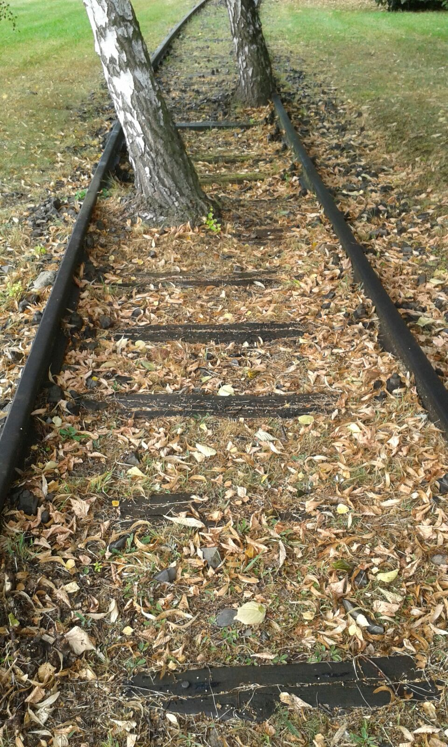
Build it they will come?
Various papers question success of institutional repositories
Lots of use of third-party services
Offer poor tailoring to user needs
Notes:
Empty repositories or a ‘roach motel’ (data goes in but doesn’t come out) – Dorothea Salo

Slide 4
Low use of university services
Results from 2016 DAF surveys
www.slideshare.net/JiscRDM/daf-survey-results-research-data-network

Slide 5
Need to listen and respond to users
“Please, individualise the support. Workshops are useless, emails with information are useless, brochures are useless, posters are useless.”
Quote from 2016 DAF survey results

Slide 6
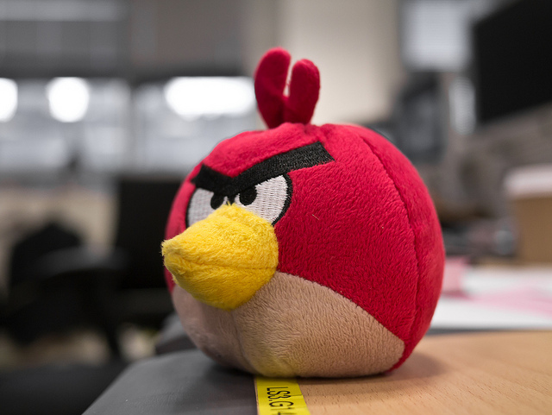
Tailor arguments to audience
What will drive one group to act could cause another to disengage
Top down
Compliance driven
Firm mandates
Single solution
→
Image CC-BY-NC-ND ‘Angry’ by Justin www.flickr.com/photos/jp3g/6238543889

Slide 7
Engaging researchers
Image CC-BY-SA by Dawn Manser www.flickr.com/photos/dawnmanser/3532598208

Slide 8
Advice from Cambridge Uni
Be collaborative and encourage co-ownership
Build trust by understanding researchers’ challenges
Never dismiss - be open to all questions
Focus on what you’re asking and why to avoid wasting time
Empower researchers to shape service delivery
https://zenodo.org/record/154352#.WH-ETlOLSUk

Slide 9
Researcher-led RDM services
Critical role in providing requirements
Researchers co-designing and testing services
Senior academics leading working groups to ensure services are fit-for-purpose and get adoption
Useful to have a senior academics in your corner – hold sway with other researchers and influential in university decision-making processes

Slide 10
Jisc co-design approach
Developing a research data shared service
15 pilot institutions feeding in requirements and testing services
Several external contractors to deliver services and broker sector-wide deals
www.jisc.ac.uk/rd/projects/research-data-shared-service

Slide 11
A democratic, open approach
Notes:
We had over 40 applicants, and selected 20, ensuring representation from various stakeholders across the University (PIs, postdocs, students, librarians, IT people, ethics person etc.). This group is split into 4 sub-working group (20 people can't work productively altogether): Outreach and Support, Preservation, Standards and System Integration, Personal/Sensitive Data and Policy. The RDM Project Group meets every 2 months and the sub-working groups report on their activities and discuss future actions (with comments from everyone). This that sub-working groups can effectively work together between meetings, but that the activities of sub-working groups are joined up. The Outreach and Support sub-working Group (Rosie is leading that Group) leads on the Data Champions project as one of their babies.

Slide 12
RDM champions or community leaders
How to make the most of early adopters / advocates?
Several UK unis establishing RDM champions programmes
Network of local data experts who can support colleagues in their discipline
Agreed responsibilities e.g. deliver disciplinary training
Acting as a catalyst for ideas and change
Others developing a data community, network or data forum
Enables exchange of ideas and engagement with colleagues
Recognising those who have embraced RDM
Discuss issues/opportunities of RDM and put forward recommendations
https://gitter.im/rdm-discussions/champions

Slide 13
Data engagement programmes
Data conversations at Lancaster University
Provide a forum for researchers to speak about their data
Engage the non-converted
Use peers to spread RDM / OS message
www.lancaster.ac.uk/library/rdm/data-conversations
Data champions at Cambridge & data stewards at TU Delft
Local support & help
Researcher-focused & led
Explicitly recognise value and role of curation
https://osc.cam.ac.uk/engaging-researchers-good-data-management

Slide 14
Don’t think the job is done
Repeat requirements gathering and gap analysis
Know your user community
Continual advocacy, awareness raising, training…
Monitor trends / changes in landscape
More open data policies
Transition to FAIR data

Slide 15
What is success?
Measure impact, not just usage stats. Focus on a relationship with services and what you help users to accomplish

Slide 16
Thanks for listening!
DCC guidance, tools and case studies:
www.dcc.ac.uk/resources
Follow us on twitter:
@digitalcuration and #ukdcc

